Slide 1

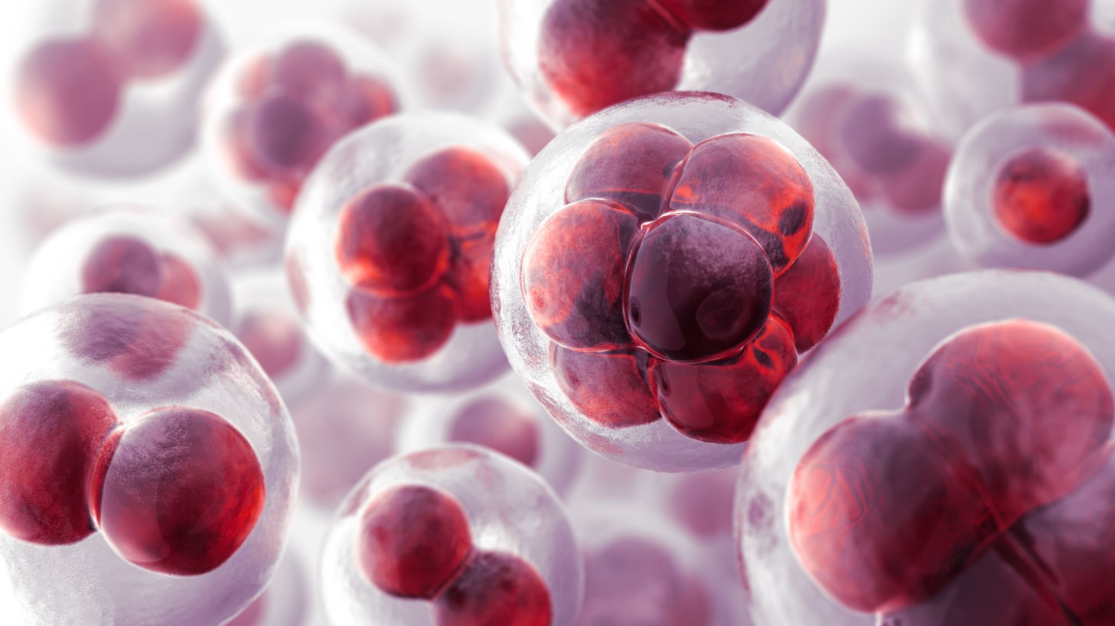




Fae Ghazi
Why Data Science is crucial in Medical/Biological Research?

Slide 2
Exploratory Data Analysis
Web Scraping
Remove Duplication
Reformatting
Missing Data
Anomaly Detection
Unpivoting Merging
Merging Based on the Time and appropriate Feature

Slide 3
Algorithms and Statistical Testing
Develop Hypothesis Test and Algorithims
Test for Comparing: T test, Anova and Post hoc to measure the difference and which group are different.
Test for Independence: Chi-Square test to determine if there's an association between two categorical variables.
Tests for Correlation: Pearson Correlation: Relationship between two Continuous Variables Sperman rank Correlation: Relationship between ordinal or continuous variables Normal Distribution Test: Shapiro-Willk Test
Non-parametrics Test: Friedman test Time Series Analysis: Augment Dickey Fuller

Slide 4
Data Science Methodology
Supervised Methods
Decision Tree
KNN
SVM
Linear Regression
Ensemble
Unsupervised Methods
K-Means
Anomaly
AssociateRules
Time Series Data
Machine Learning approach
Elastic Net
MARS
SVM
KNN
Random Forest
XGBOOST
Time Series modelling approach
Prophet
Tsfresh
Darts
Kats
GreyKite
AutoTS
Autoregressive
SARIMAX
VARMA
Text Data
Sentiment
Topic_modelling_LDA
Text_classification
Translator_seq2seq
Summarization_Bar_Colab
NLP Approach

Slide 5
Feature Engineering
Regularization Techniques Lasso and Ridge
Decision Tree, Random Forest and Gradian Boosting Trees that provide feature importance score
Dimension reduction (PCA , LDA)
Distribution of features with target variables: If feature has no variation between two classes, it is not important.
Visualize train and test and Removing Features to avoid overfitting

Slide 6
Statistical Metrics Scores
Time series
Mean Absolute Error (MAE)
Linear regression
Mean Absolute Error (MAE)
Classification
Confusion Metrics(accuracy, precision, recall)
Unsupervised
Silhouette Coefficient
ROC, AUC, Kappa, F1 Statistics
Mean Squared Error (MSE), Root Mean Square Error(RMSE)
Mean Absolute Percentage Error (MAPE)
R-Squared,
AIC/BIC
Mean Squared Error (MSE), Root Mean Square Error(RMSE)
R-Squared
F-Statistics
Calinski-Harabasz Index (Variance Ratio Criterion)

Slide 7
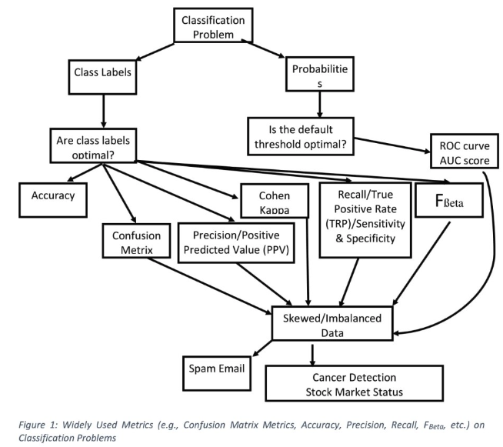
Performance Metrics For Classification
Confusion metrics, Accuracy, Precision, Recall, F1 score, ROC Curve
Source: What Are True Statistical Metrics for Classification Models? Fae Ghazi, September 18, 2022.
https://www.linkedin.com/pulse/what-true-statistical-metrics-classification-models-fae-ghazi%3FtrackingId=0RVJd8%252BYIqWF7bXYxdNhVA%253D%253D/?trackingId=0RVJd8%2BYIqWF7bXYxdNhVA%3D%3D

Slide 8
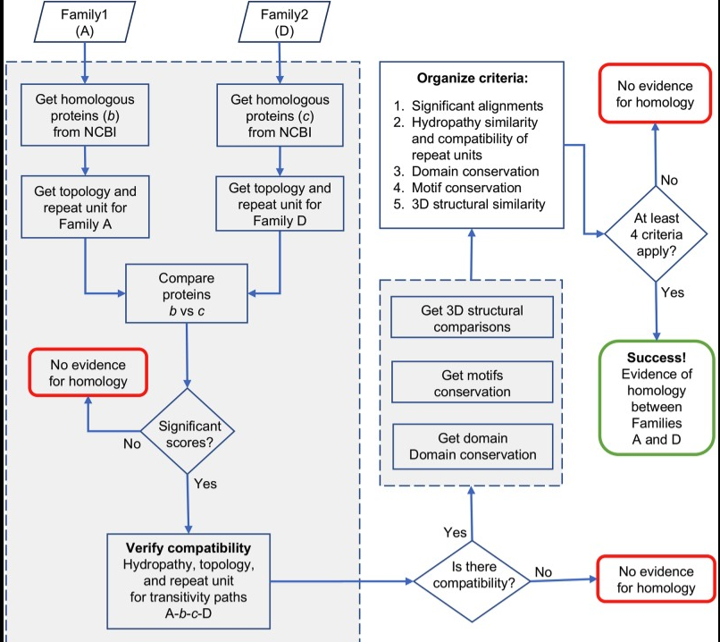
How to Solve the Problem through algorithms
Source:
“Expansion of the Transporter-Opsin-G protein-coupled receptor superfamily with five new proteins families”. PLOS ONE, April 2020 [first author].
https://www.ncbi.nlm.nih.gov/pmc/articles/PMC7304584/

Slide 9
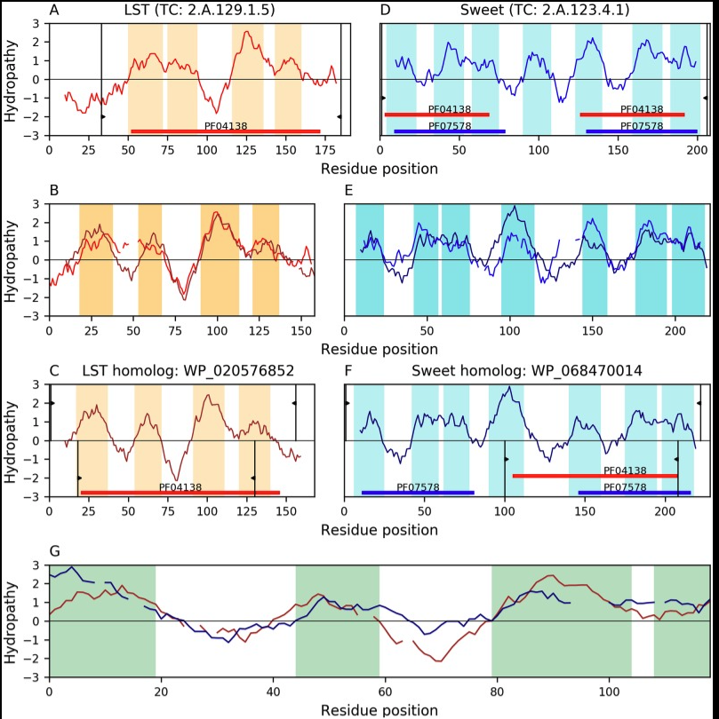
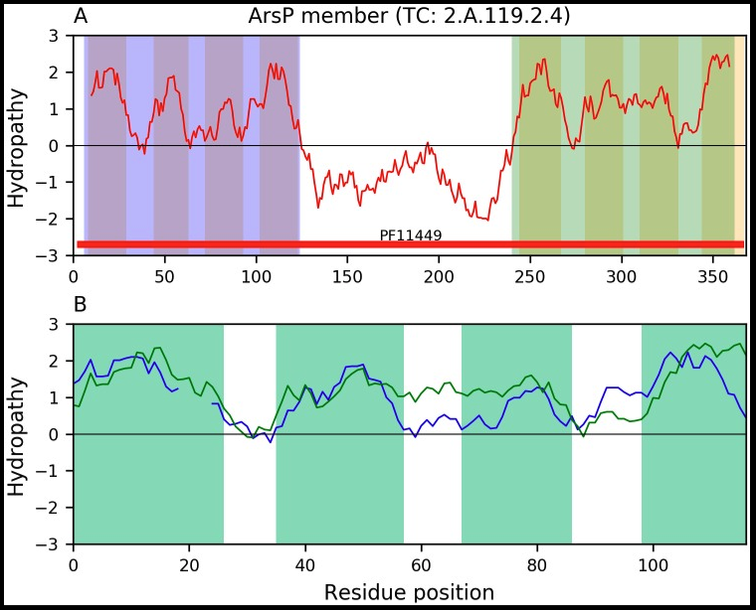
Anomaly Detection
Anomaly is detected based on the topologies of transmembranal segments (TMSs) and structural, functional, and evolutionary relationships. Source:
“Expansion of the Transporter-Opsin-G protein-coupled receptor superfamily with five new proteins
families”. PLOS ONE, April 2020 [first author].
https://www.ncbi.nlm.nih.gov/pmc/articles/PMC7304584/

Slide 10
Web Scraping and Statistical Analysis project Description: Statistical Comparative Analysis of Relevant TOG Families: Insights from Table 3 Data Source: “Expansion of the Transporter-Opsin-G protein-coupled receptor superfamily with five new proteins families”. PLOS ONE, April 2020, Faezeh Ghazi. https://www.ncbi.nlm.nih.gov/pmc/articles/PMC7304584/
 | Homology transitivity path |  |  |  | Alignment E-values |  |  | TMS Aln†
 | Family A | Homolog B | Homolog C | Family D | A vs B | B vs C | C vs D
New members | 2.A.119.1.6 (ArsP) | WP_082464241 | AHF91483 | 2.A.102.4.1 (TSUP) | 5.0×10⁻⁴⁷ | 8.5×10⁻¹¹ | 3.2×10⁻²⁸ | 3
 | 9.B.191.1.7 (KDELR) | KXJ91449 | XP_010536596 | 2.A.123.1.27 (Sweet) | 1.7×10⁻¹²⁸ | 5.3×10⁻¹⁰ | 5.6×10⁻⁵⁶ | 7
 | 2.A.105.1.1 (MPC) | XP_008085704 | BAJ94651 | 2.A.123.1.13 (Sweet) | 2.1×10⁻²⁹ | 4.7×10⁻¹⁰ | 1.1×10⁻⁷¹ | 3
 | 2.A.104.1.1 (AlaE) | WP_039030005 | WP_087291645 | 2.A.119.2.2 (ArsP) | 4.4×10⁻⁶⁹ | 1.8×10⁻⁸ | 4.9×10⁻⁶¹ | 4
 | 2.A.129.1.5 (LST) | WP_020576852 | WP_068470014 | 2.A.123.4.1 (Sweet) | 8.8×10⁻³⁵ | 1.5×10⁻⁸ | 6.3×10⁻²¹ | 4
Core members | 2.A.43.3.2 (LCT) | XP_005085010 | WP_088318471 | 2.A.123.3.3 (Sweet) | 1.1×10⁻⁸⁵ | 2.8×10⁻¹⁰ | 1.7×10⁻¹¹ | 7
 | 2.A.43.2.1 (LCT) | XP_010897069 | AJQ93431 | 2.A.102.4.13 (TSUP) | 5.9×10⁻⁸⁶ | 3.4×10⁻¹⁰ | 8.6×10⁻³⁰ | 4
 | 2.A.43.2.3 (LCT) | XP_021870097 | PAA59477 | 2.A.82.1.1 (OST) | 5.4×10⁻⁴⁹ | 6.3×10⁻⁷ | 5.6×10⁻²⁶ | 4
 | 2.A.52.1.1 (NiCoT) | WP_060363333 | OXS28752 | 2.A.102.4.7 (TSUP) | 6.1×10⁻⁶⁴ | 1.8×10⁻⁸ | 1.4×10⁻¹⁷ | 6
 | 3.E.1.1.2 (MR) | WP_047004083 | XP_022019458 | 2.A.123.1.23 (Sweet) | 1.9×10⁻²⁴ | 2.9×10⁻¹⁰ | 3.2×10⁻³⁹ | 5
 | 3.E.3.1.7 (HelioR) | KKP65948 | SAM69932 | 3.E.1.4.3 (MR) | 1.1×10⁻⁶⁸ | 9.4×10⁻¹⁰ | 2.0×10⁻⁴¹ | 5
 | 3.E.1.4.2 (MR) | AHH02121 | XP_009982643 | 9.A.14.13.7 (GPCR) | 2.6×10⁻¹³ | 9.0×10⁻⁷ | 9.5×10⁻³⁵ | 5
All comparisons were congruent with the alignment of hydrophobic peaks, the agreement of repeat units and Pfam domain content. E-values are shown for the alignments A-B, B-C, and C-D across the homology transitivity paths. B-C E-values relating families A and D are shaded. † Number of hydrophobic peaks (putative TMSs) involved in the B-C alignment (Aln).

Slide 11
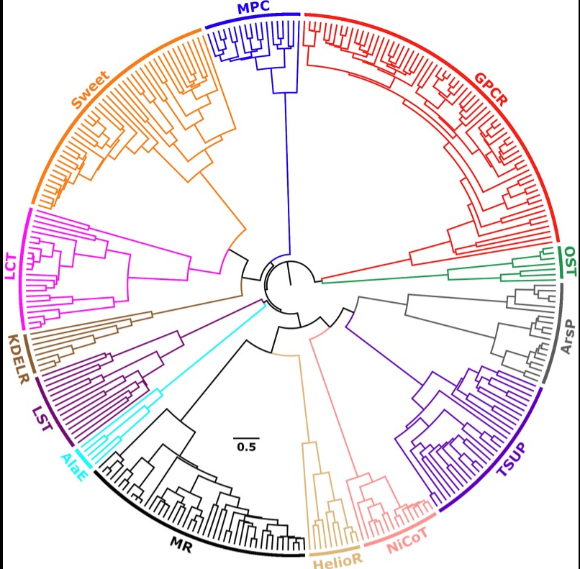
Radial tree of protein sequence similarities within the TOG superfamily
Description: Different homologous family sequences are represented with different colors.
Source: “Expansion of the Transporter-Opsin-G protein-coupled receptor superfamily with five new proteins families”. PLOS ONE, April 2020, Faezeh Ghazi. https://www.ncbi.nlm.nih.gov/pmc/articles/PMC7304584/

Slide 12
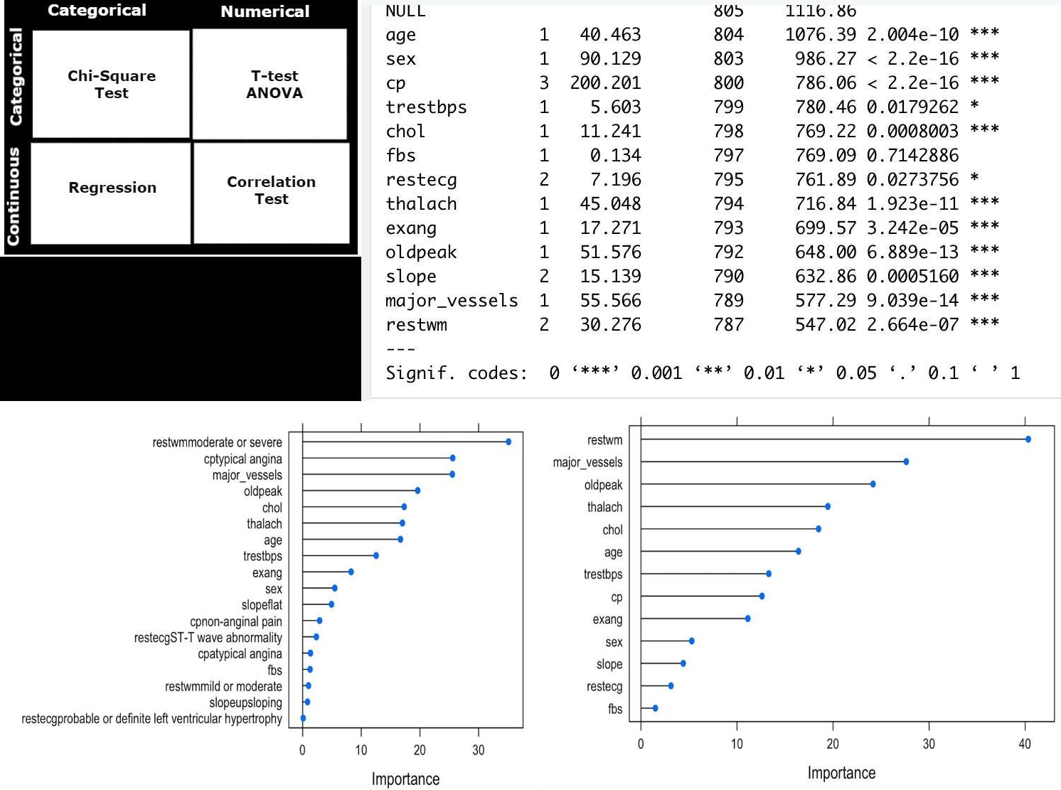
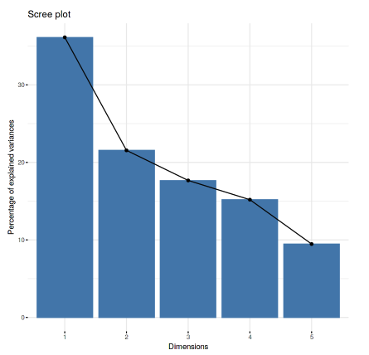
Feature Selection And Statistical Testing
In heart disease project, Anova test cannot indicate the significance of each feature of categorical variable with the target. However, the visualization of feature importance can be done using the visualization of variable importance, performed in statistical R.
Source:
https://www.linkedin.com/in/fae-g-11a1201b0/recent-activity/all/

Slide 13
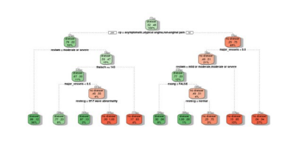
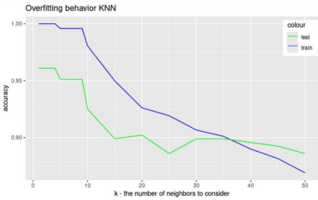
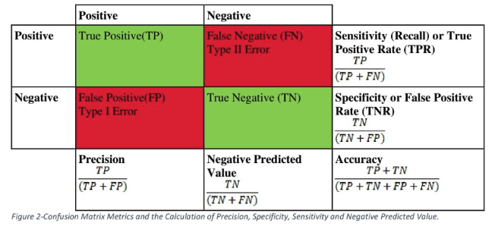
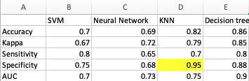
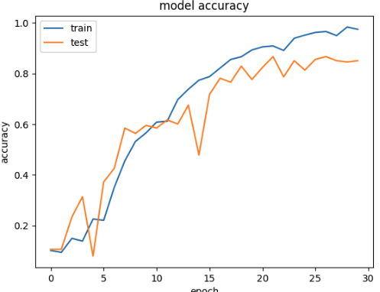
Feature removing and selection of Best Models
Based about data such as balance or imbalance or disease or not disease data, we will select the best models.

Slide 14
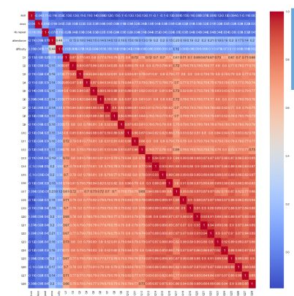
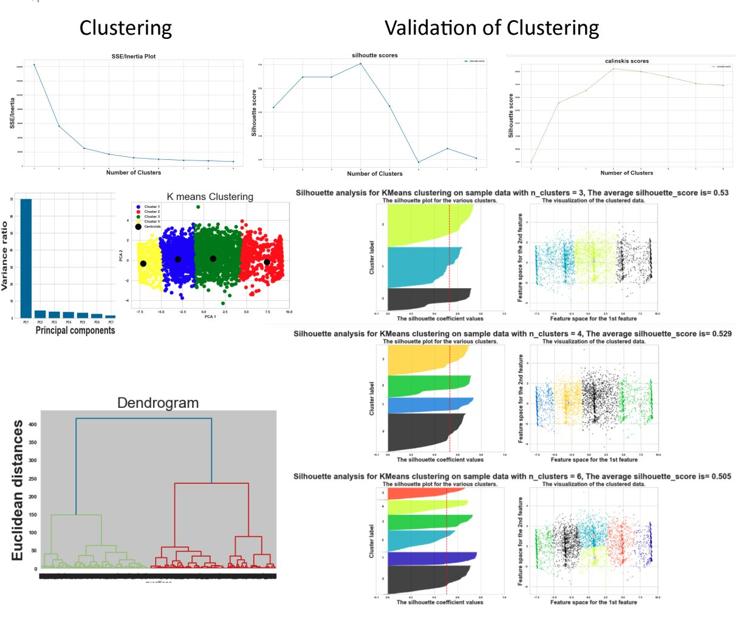
How Many Clusters?
The evaluation of goodness of clusterings(Internal and external) are through considering how well the clusters are separated and how compact the clusters are. This internal (unlabeled) evaluation of clusterings are through metric scores of silhouette coefficients and Calinski-Harabasz Index
Source: https://www.linkedin.com/in/fae-g-11a1201b0/recent-activity/all/

Slide 15
Time Series Project
Data Contains Time and Call Volumes
Multivariate Time Series Forecasting for Covid19 Wave

Slide 16
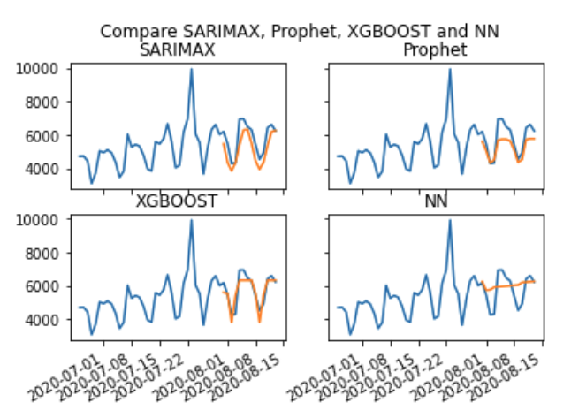
which model can be used for COVID-19 forecast COVID-19 Global Daily Deaths dataset by Johns Hopkins
Model | MAE
XG-Boost | 392.15
Prophet | 572.56
SARIMAX | 650.62
Neural Network(NN) | 728

Slide 17
Data Science Methodology
Bayesian-network
PC- IDA-PC simple
Hiton- Markov Blanket
RNAseq project with Markov blankets

Slide 18
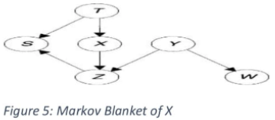
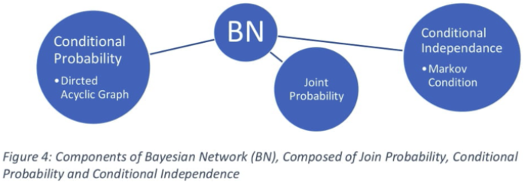
Bayesian network and feature Selection through Markov Blanket
Description:
Markov blanket of a node emphasized the set of nodes composed of its parents, its children, and its children's other parents. It is conditional independence of other nodes.
Source: “Gene regulatory Network”, Ghazi, Faezeh, Journal of molecular Biology, June 2023. Submitted (Under Review).

Slide 19
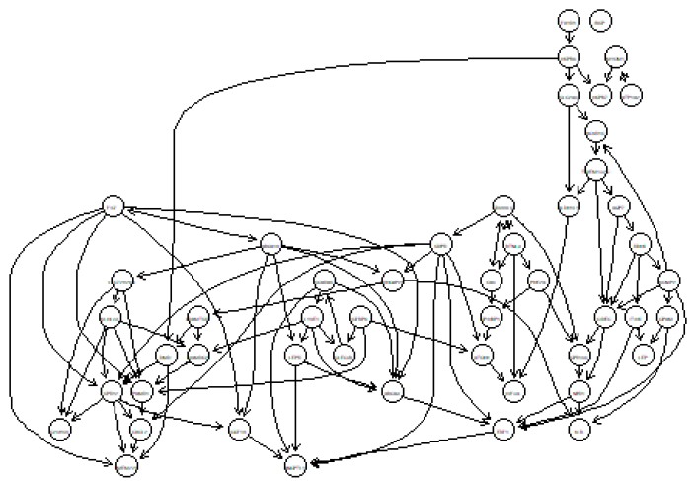
Gene Regulatory Network Using PC Algorithm

Slide 20
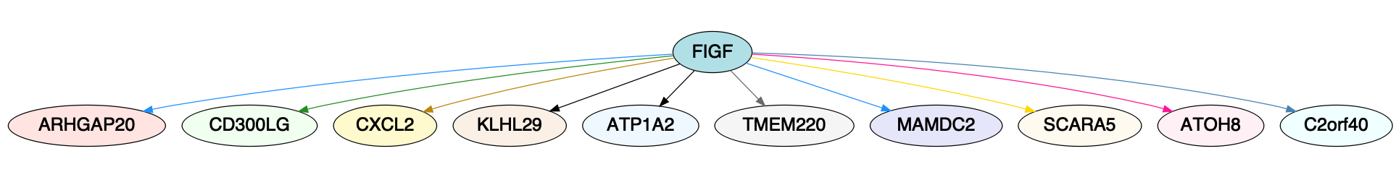
Bayesian network and Causality with PC-algorithim
Description: In order to discretize and do feature selection, the PC- algorithm is used to determine parent and children of genes. FIGF has significant role in promoting blood supply to tumors.
Source: “Gene regulatory Network”, Ghazi, Faezeh, Journal of molecular Biology, June 2023. Submitted (Under Review).

Slide 21
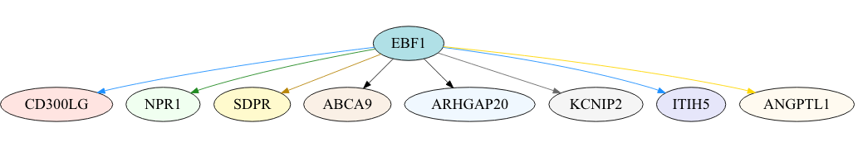
Description: Determination of Important Genes: Top 10 Genes Influencing EBF1 Ranked by zMin Values. In this project that is focusing on gene disease association of Leukemia , the parent and child nodes of EBF1 is found. Source: Faezeh Ghazi, June 2023. “Gene regulatory Network”, Journal of molecular Biology, Submitted.

Slide 22
Description: Comparison of Accuracy Performance for All selected Features and All Features. In this cancer gene, the Accuracy, Specificity or Sensitivity? Data is imbalanced, so accuracy is not good indicator. Since the data is associated with blood diseases, precision and specificity is important as we want the increase of true positive.
 | Accuracy | Precision | F1
All Features | 0.967 | 0.68 | 0.80
Selected Features by PC-Simple | 0.97 | 0.75 | 0.85

Slide 23
Conclusion of Confusion Metrix
It can be seen the importance of feature selection and how using relevant features can enhance the performance of a model. The PC-algorithm, which is a causal structure learning algorithm, helps in identifying such influential features, leading to improved results.

Slide 24
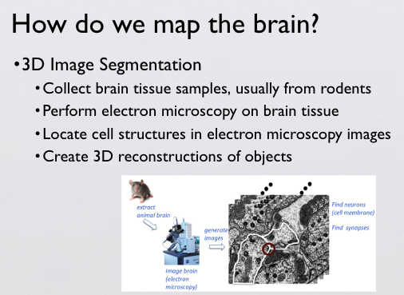
Source
"Neuronal Circuit and Synapse Analysis with Deep Neural Networks", a research project applying deep neural networks to the analysis of neuronal circuits and synapses, presented at the University of California, San Diego, June 2020, [Faezeh Ghazi]. Available at: https://library.ucsd.edu/dc/object/bb5500301x

Slide 25
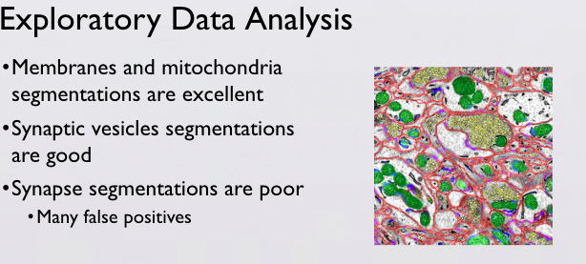
Description:
This shows the Problems with synaptic area.
Source:
"Neuronal Circuit and Synapse Analysis with Deep Neural Networks", a research project applying deep neural networks to the analysis of neuronal circuits and synapses, presented at the University of California, San Diego, June 2020, [Faezeh Ghazi]. Available at: https://library.ucsd.edu/dc/object/bb5500301x

Slide 26
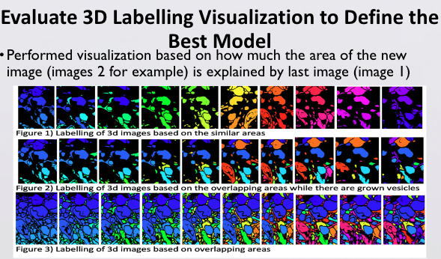
Description:
Prediction of Neuronal Circuit and Synapse Analysis with Deep Neural Networks. In this project, 3D statistical vesicle filtering and identified erosion models with tuned threshold on 3D objects is designed to improve the model performance, used by deep learning method of LSTM
Source:
"Neuronal Circuit and Synapse Analysis with Deep Neural Networks", a research project applying deep neural networks to the analysis of neuronal circuits and synapses, presented at the University of California, San Diego, June 2020, [Faezeh Ghazi]. Available at: https://library.ucsd.edu/dc/object/bb5500301x

Slide 27
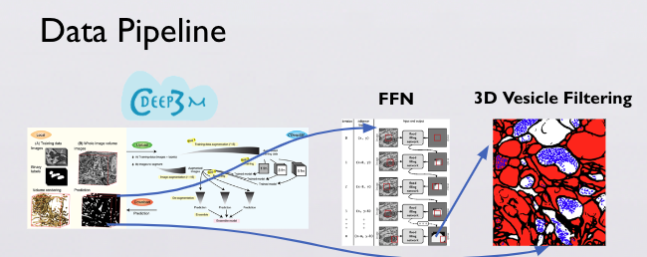
Description: Prediction of Neuronal Circuit and Synapse Analysis with Deep Neural Networks. this project, more accurate synaptic location of brain was predicted, using image processing, statistical methods, and CNN models in synapsis analysis project of electron microscopic 3D images derived from brain tissue.
Source: "Neuronal Circuit and Synapse Analysis with Deep Neural Networks", a research project applying deep neural networks to the analysis of neuronal circuits and synapses, presented at the University of California, San Diego, June 2020, [Faezeh Ghazi]. Available at: https://library.ucsd.edu/dc/object/bb5500301x

Slide 28

Thank you for your time

Slide 29
Statistical Metrics Scores
In Both Time series and Linear regression, the target is continuous. Time Series Models: The goal is often to predict future values based on past observations Mean Absolute Error (MAE) Mean Squared Error (MSE)
Root Mean Squared Error (RMSE) Mean Absolute Percentage Error (MAPE)
Supervised: Regression: MAE, MSE, R2 Classification: Confusion metrics, Accuracy, Precision, Recall, F1 score, ROC Curve Unsupervised: Silhouette Score, Kmeans score

Slide 30
Time Series and Machine Leaning Optimization via Hyperparameters Tunning

Slide 31
Time Series Steps of Projects
Time Series Project on Univariate and Multivariate Variable Parametric Technique and Non-Parametric Technque
Staionary data (Visualization and ADF test)
ACF and PACF and Spearmann Correlation for ARIMA
Plot Predicted and Real Data to Validate and See the overfitting
Validate Based on Statistical Metrics

Slide 32
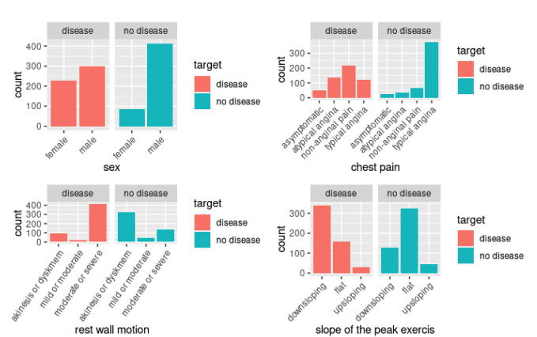
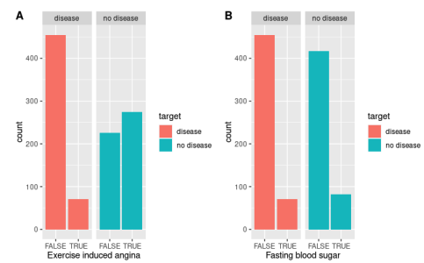
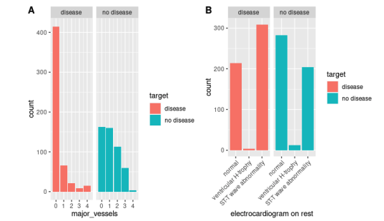
Distribution of Target Heart disease with explanatory Variables
It can be seen how the distribution of variables changes. If they are skewed to the right, left and with box plot, e can see outliers.
Source:
https://www.linkedin.com/in/fae-g-11a1201b0/recent-activity/all/

Slide 33
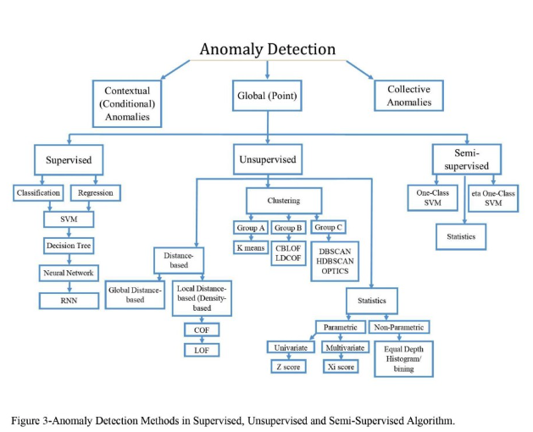
Descriiption
Source:

Slide 34
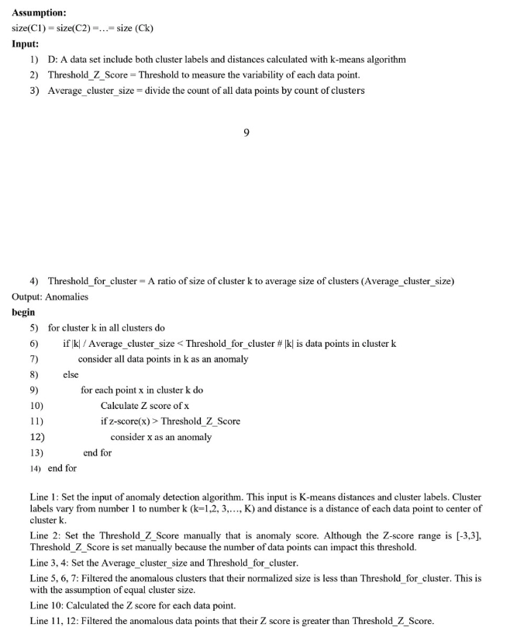
Pseudo codes for Anomaly Detection

Slide 35
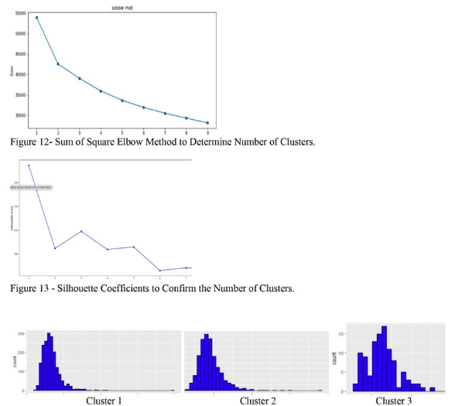
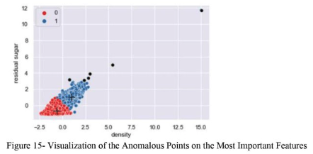
Anomaly Detection Methods

Slide 36
Feature Selection and Performance Improvement
Emphasize the importance of feature selection.
Steps: Feature selection with PC-simple, evaluation using Naive Bayes, and performance metric creation.
Figures: Use Figure 6 for PC-simple implementation, Figure 7 for Naive Bayes with selected features, Figure 8 for performance metrics, and Figure 9 & 10 for Naive Bayes with all features.

Slide 37
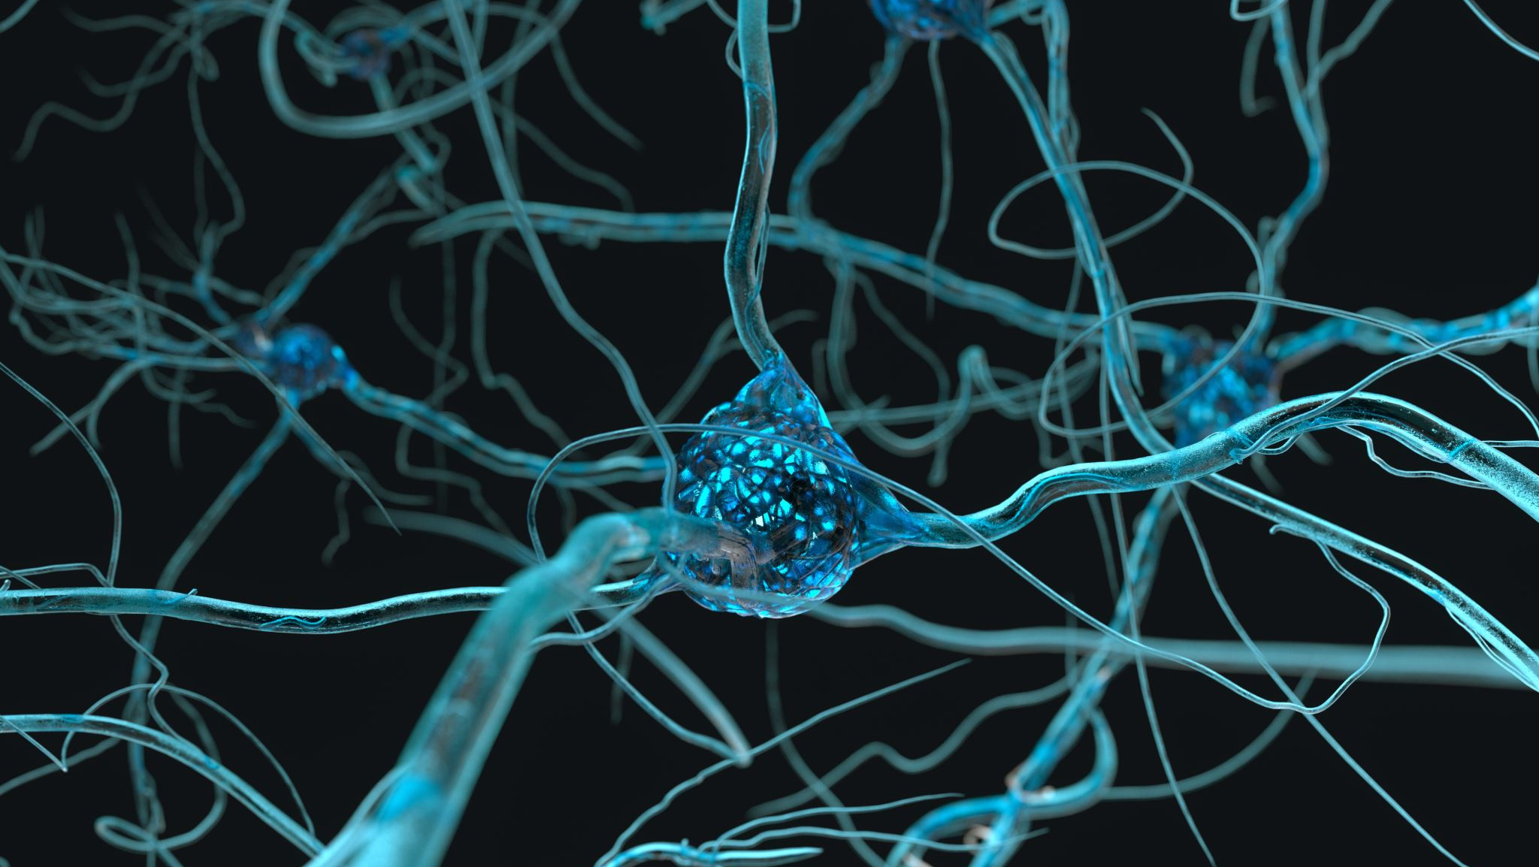
Computer Vision Project
Neuronal Circuit and Synapse Analysis with Deep Neural Networks”. Applied Convolutional Neural Network (CNN) to determine the most accurate synaptic location of brain.

